Slide 1
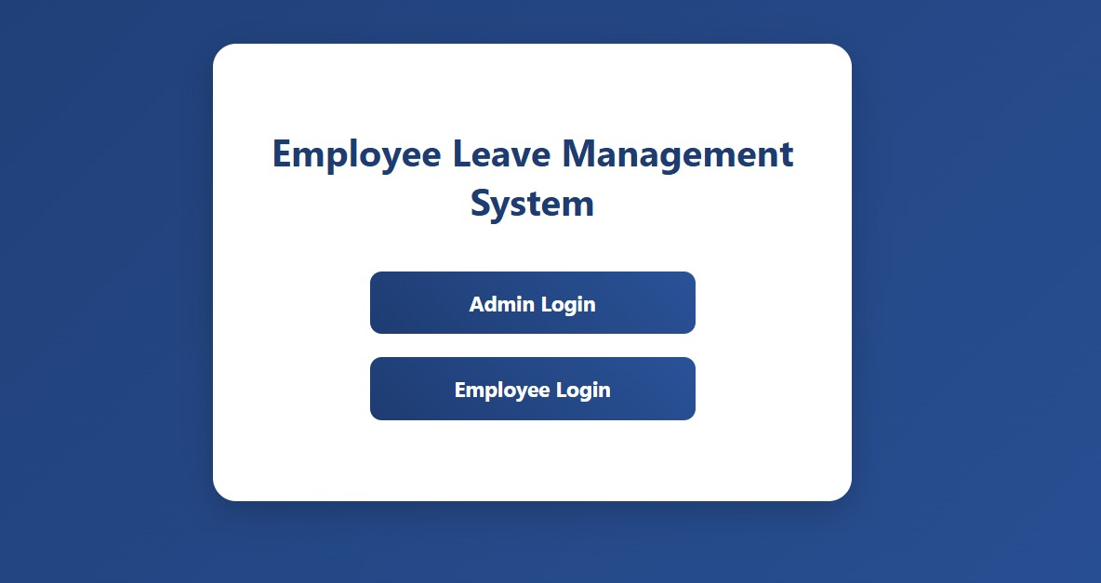
EMPLOYEE LEAVE MANAGEMENT SYSTEM
A Web-Based Application for Managing Employee Leave Requests, Approvals, and
leave Status Tracking Efficiently
SUBMITTED BY:
P VENKATA RAJESH KUMAR
23AK1A05M8
CSE-4
BATCH : FULLSTACK-4

Slide 2
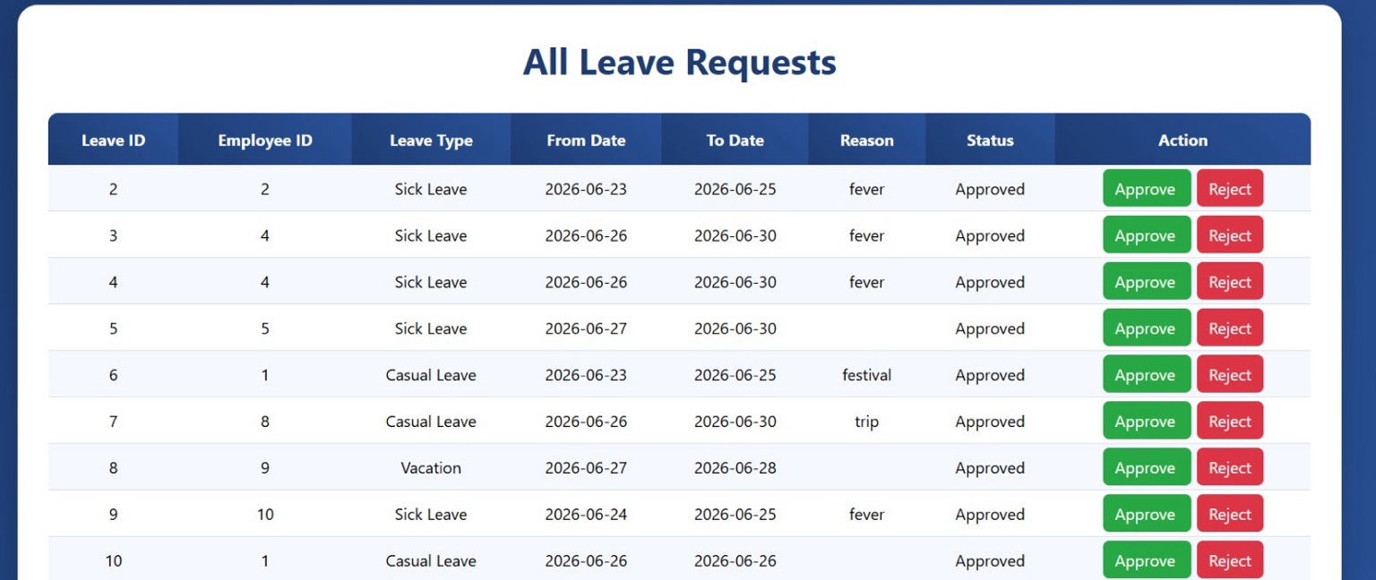
Problem Statement
• Manual leave management consumes
more time and effort.
• Paper-based leave records are difficult to
maintain and update.
• Employees cannot easily know the status
of their leave applications.
• Administrators face difficulties in
approving and tracking employee leaves.
• Hence, an automated online leave
management system is required.

Slide 3
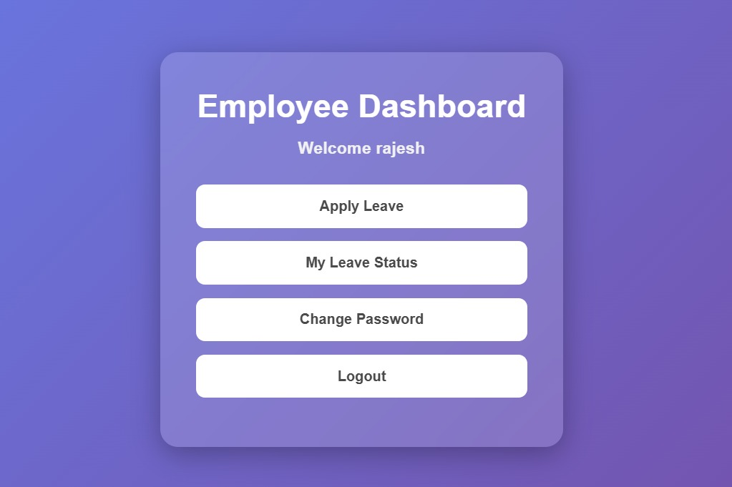
Methodology / Approach
1. Requirement Analysis – Identify employee and administrator needs.
2. System Design – Design user interfaces and database schema.
3. Development – Implement modules using HTML, CSS, JSP, Servlets and JDBC.
4. Database Integration – Store leave records using MySQL.
5. Testing – Verify login, leave application and approval modules.

Slide 4
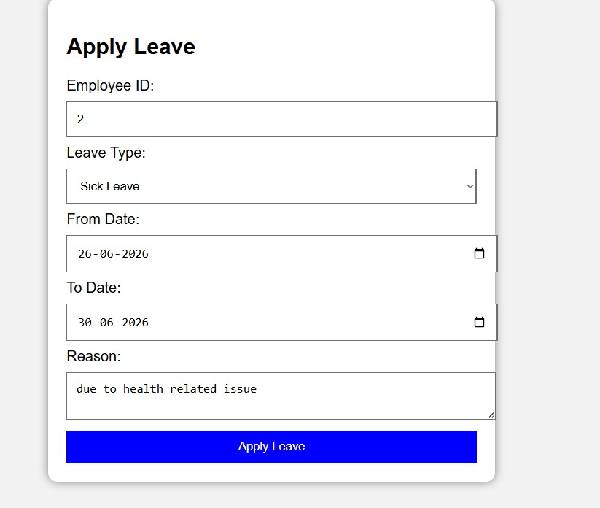
Results / Outcome
• Employees can securely login and
apply for leave.
• Administrators can approve or reject
leave requests.
• Employees can track leave status in real
time.
• All employee leave details are stored
securely in the database.
• The system reduces paperwork and
improves organizational efficiency.

Slide 5
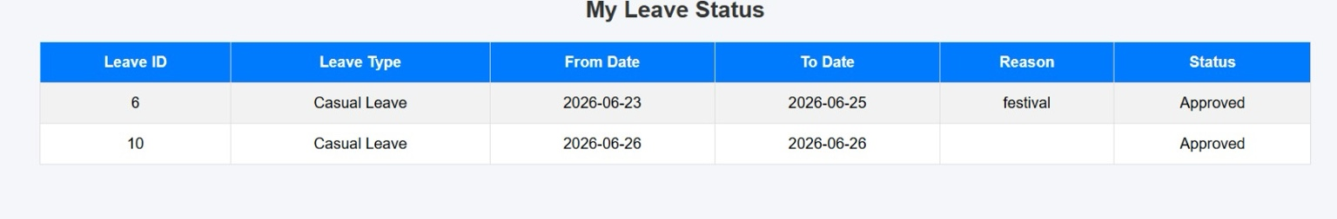
Conclusion
The Employee Leave Management System successfully automates the leave management
process. The system improves transparency, reduces manual work, and provides quick
access to leave information.
Future Enhancements:
• Email Notifications
• Cloud Deployment
• Mobile Application Support
THANK YOU

